Slide 1
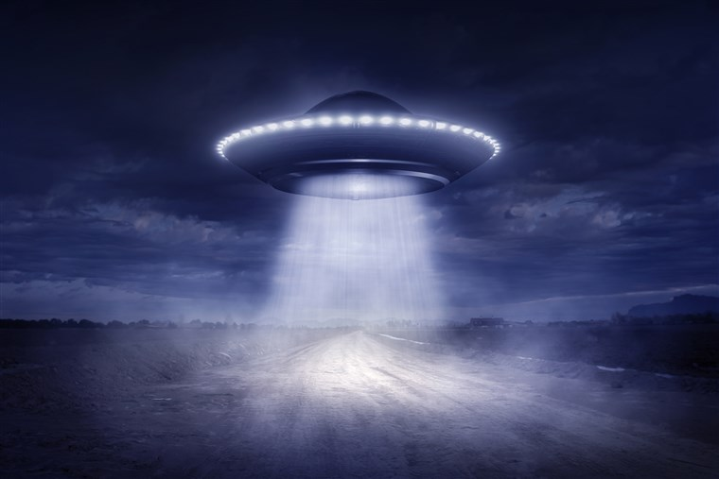
Project X-Files: UFO Sightings Fact or Fallacy
Project 1 : Aaron, besmir, candra, doug
4/25/2019

Slide 2

Why UFO Research?
Pentagon ended UFO Research program in 2012
UFO has long standing presence in American conscience from books, movies, to popular commercials and television shows
UFO sightings and belief of alien presence is a huge cultural phenomena in US
Especially compared to other countries
Our research delves deeper into this US based phenomena & provides data insight into the history of our otherworldly friends

Slide 3
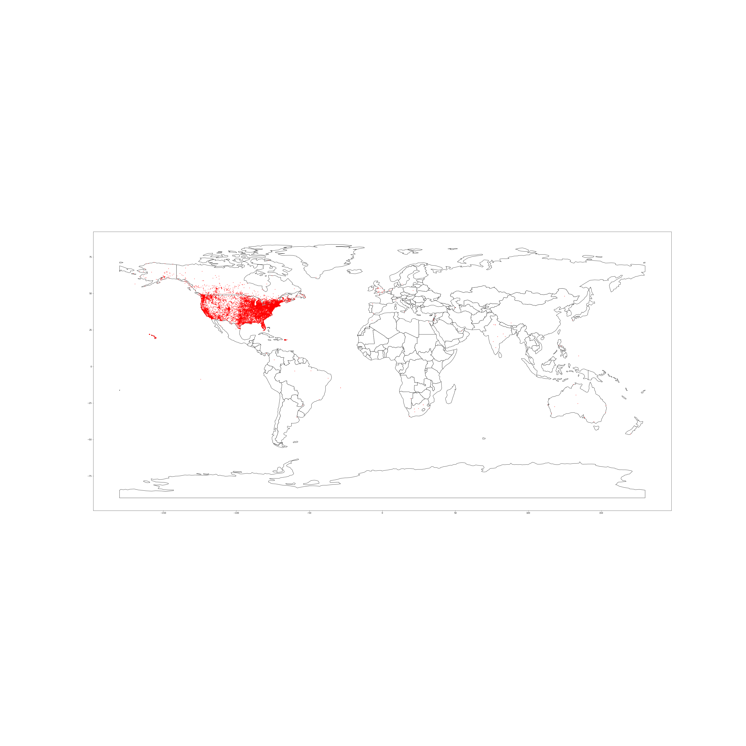
What are the top 10 countries with the highest UFO sightings?
United States
Canada
Great Britain
Australia
Mexico
India
Germany
Netherlands
Brazil
New Zealand

Slide 4
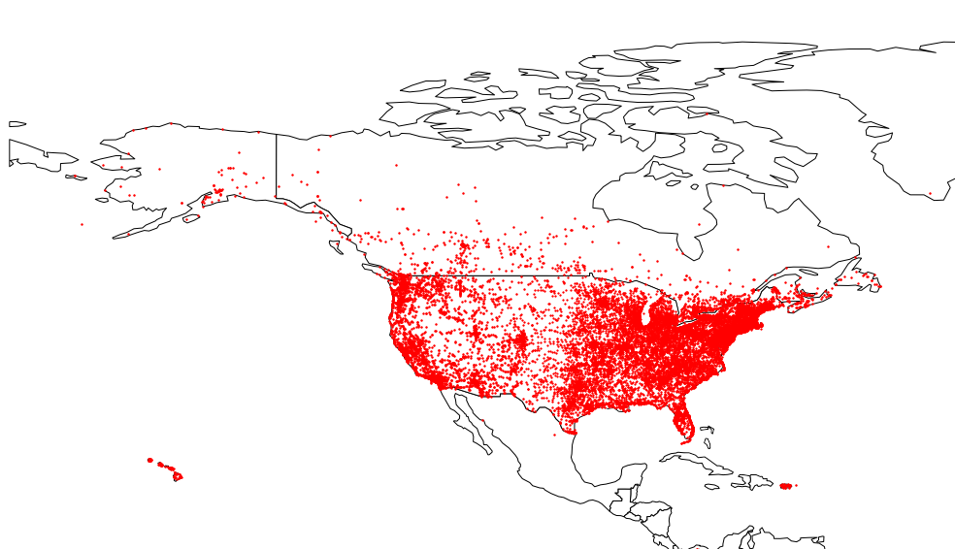
UFO SIGHTINGS IN THE U.S.

Slide 5
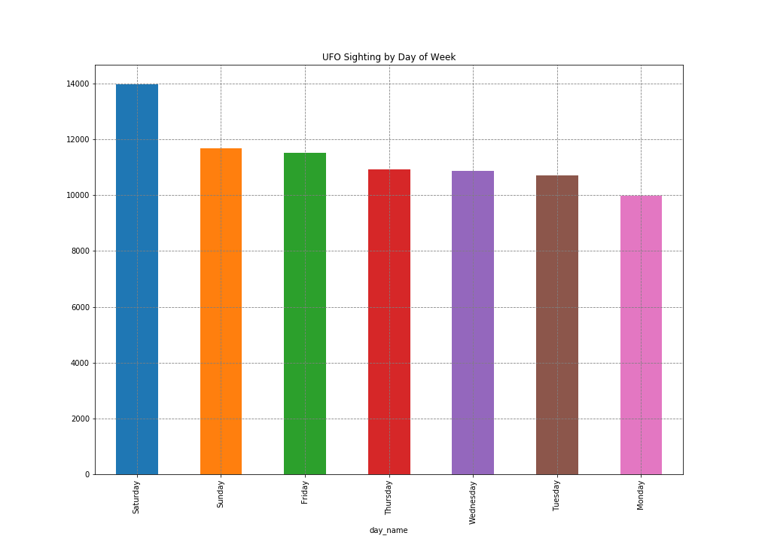
Day of week

Slide 6
Top 10 date/times to see a UFO
day_name | hour | counts | percentage
Saturday | 22 | 2153 | 2.703619057
Saturday | 21 | 2078 | 2.60943818
Thursday | 21 | 1701 | 2.136022302
Friday | 21 | 1697 | 2.130999322
Friday | 22 | 1648 | 2.069467815
Wednesday | 21 | 1590 | 1.996634603
Saturday | 23 | 1572 | 1.974031193
Sunday | 21 | 1538 | 1.931335862
Wednesday | 22 | 1502 | 1.88612904
Tuesday | 21 | 1483 | 1.862269885

Slide 7

WHICH CITIES HAVE THE MOST UFO SIGHTINGS?
Seattle, WA
New York, NY
Phoenix, AZ
Las Vegas, NV
Los Angeles, CA
San Diego, CA
Portland, OR
Houston, TX
Chicago, IL
Tucson, AZ
1992: E.T. Making his way to Hollywood

Slide 8
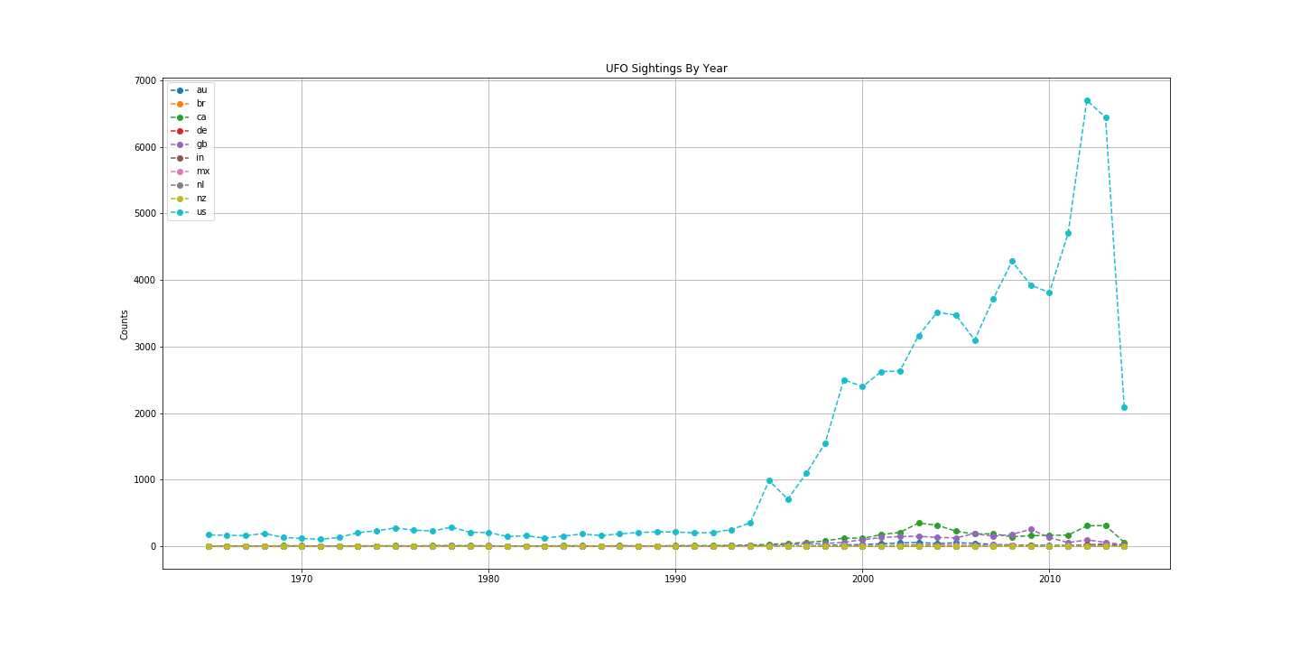
UFO SIGHTINGS THROUGH THE CENTURY

Slide 9
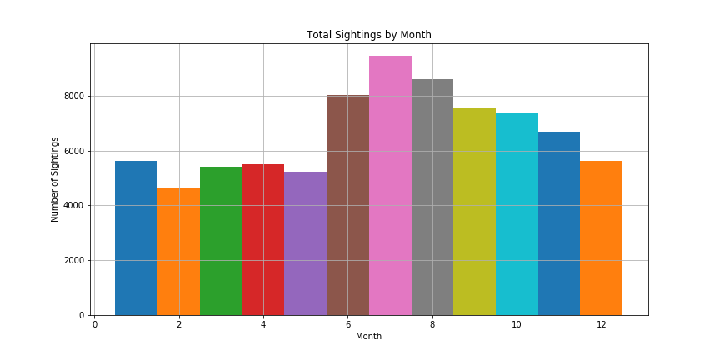
WHAT IS THE MOST POPULAR MONTH TO SEE A UFO?

Slide 10
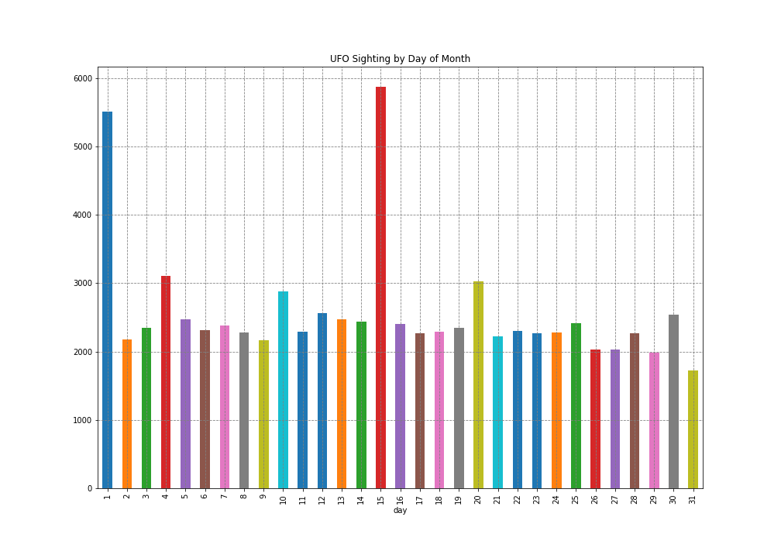

WHAT ARE THE MOST POPULAR DAYS TO SEE A UFO?
Research shows the 1st and the 15th
More likely to see UFOs on Pay Day !

Slide 11
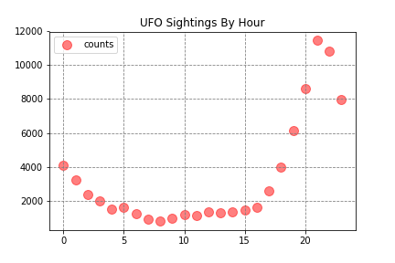
WHAT IS THE MOST LIKELY TIME OF DAY TO SEE A UFO?

Slide 12
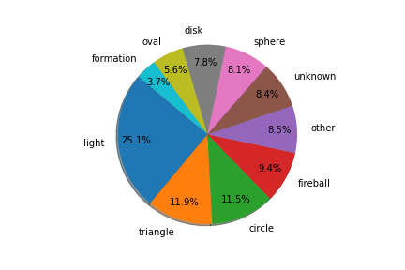
WHAT IS THE MOST COMMON UFO SHAPE?

Slide 13
SYNOPSIS
UFO sightings have greatly decreased since 2012 due to the cessation of the UFO program by the Pentagon
UFO’s are more likely to be seen in the summer months, potentially due to persons spending more time outside
Usually UFO sightings are seen late at night between 8-11:00pm
Most commonly seen UFO shape is a light shape which could easily be confused with an aircraft etc., so more research can be done here to understand what “light shape” means
Limitations of the data set is that we don’t have demographic data
Would have been interesting to see if there is a correlation between income, race, or age

Slide 14
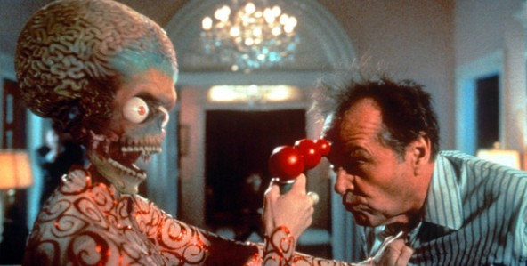
Until then….

